Slide 1
Natting
NATTING

Slide 2
Private vs Public IP Addresses
Natting
Whatever connects directly into Internet must have public (globally unique) IP address
There is a shortage of public IPv4 address
So Private IP addresses can be used within a private network
Three address ranges are reserved for private usage
  10.0.0.0/8
  172.16.0.0/16 to 172.31.0.0/16
  192.168.0.0/24 to 192.168.255.0/24
A private IP is mapped to a Public IP, when the machine has to access the Internet

Slide 3
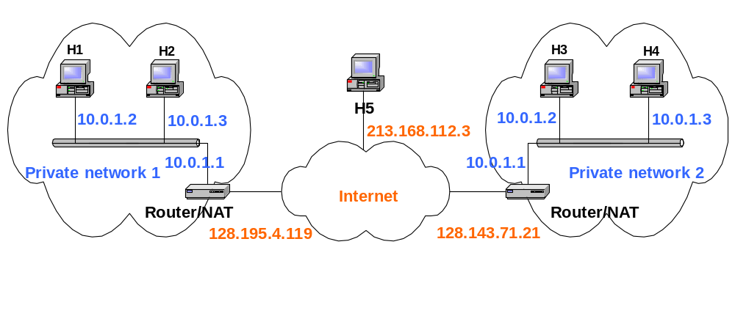
NAT
Natting
NAT (Network Address Translation) Maps Private IPs to Public IPs
It is required because of shortage of IPv4 Address

Slide 4
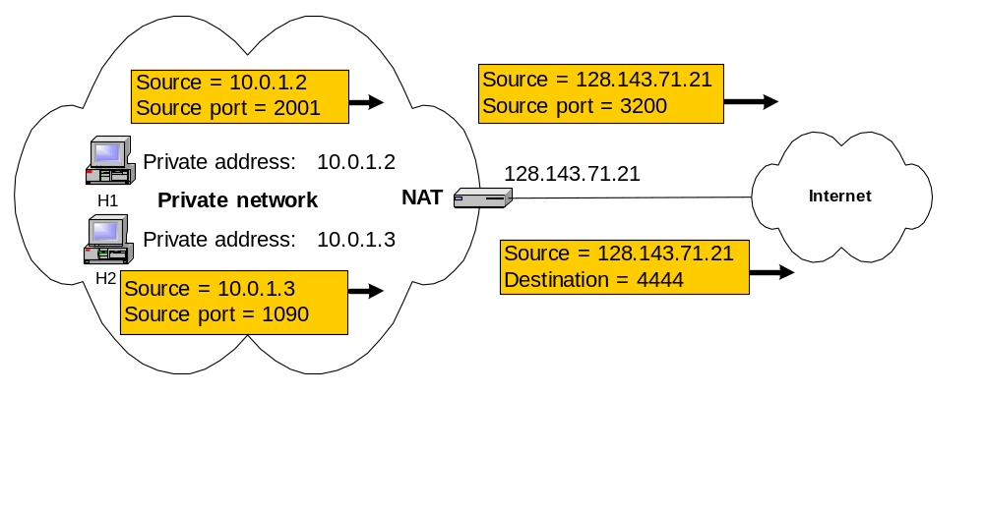
NAT
Natting
Static NAT : Maps unique Private IP to unique Public IP
Dynamic NAT : Maps Multiple Private IP to a Pool of Public IPs (Port Address Translation : Maps a Public IP and Port Number to a service in Private IP)

Slide 5
SNMP
SNMP

Slide 6
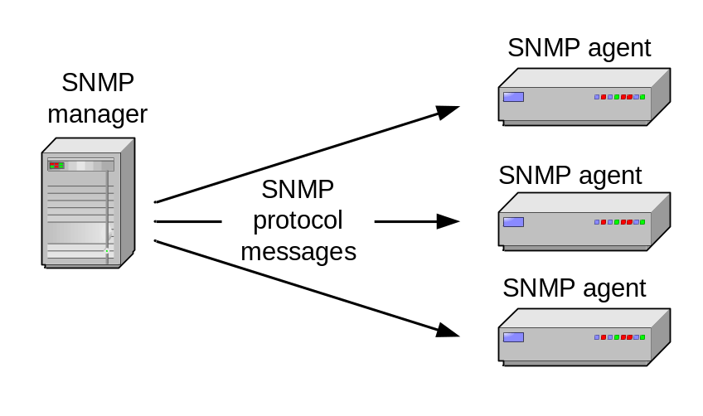
Simple Network Management Protocol
SNMP
SNMP is a framework that provides facilities for managing and monitoring network resources on the Internet.
Components of SNMP:
  SNMP agents
  SNMP managers
  Management Information Bases (MIBs)
  SNMP protocol itself

Slide 7
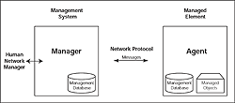
SNMP
SNMP
SNMP is based on the manager/agent model consisting of a manager, an agent, a database of management information, called as MIB.
The manager provides the interface between the human network manager and the management system.
The agent provides the interface between the manager and the physical device(s) being managed.

Slide 8
SNMP
SNMP
SNMP uses five basic messages (GET, GET-NEXT, GET-RESPONSE, SET, and TRAP) to communicate between the manager and the agent.
The GET and GET-NEXT messages allow the manager to request information for a specific variable. The agent, upon receiving a GET or GET-NEXT message, will issue a GET-RESPONSE message to the manager with either the information requested or an error indication as to why the request cannot be processed.
A SET message allows the manager to request a change be made to the value of a specific variable in the case of an alarm remote that will operate a relay. The agent will then respond with a GET-RESPONSE message indicating the change has been made or an error indication as to why the change cannot be made.
The TRAP message allows the agent to spontaneously inform the manager of an ‘important’ event.

Slide 9
VPN
VPN

Slide 10
VPN
VPN
VPN is a private connection between two systems or networks over a shared or public network (typically Internet).
VPN technology lets an organization securely extend its network services over the Internet to remote users, branch offices, and partner companies.
In other words, VPN turns the Internet into a simulated private WAN.
VPN is very appealing since the Internet has a global presence, and its use is now standard practice for most users and organizations.

Slide 11
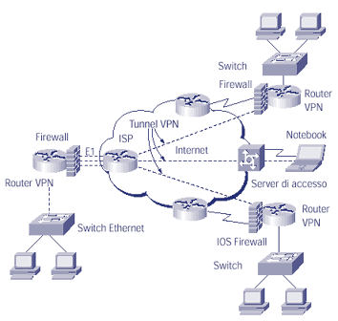
VPN
VPN

Slide 12
How VPN Works
VPN
To use the Internet as a private Wide Area Network, organizations may have to address two issues :
  First, networks often communicate using a variety of protocols, such as IPX and NetBEUI, but the Internet can only handle TCP/IP traffic. So VPN may need to provide a way to pass non-TCP/IP protocols from one network to another.
  Second data packets traveling the Internet are transported in clear text. Therefore, anyone who can see Internet traffic can also read the data contained in the packets. This is a problem if companies want to use the Internet to pass important, confidential business information.

Slide 13
How VPN Works
VPN
VPN overcome these obstacles by using a strategy called Tunneling. Instead of packets crossing the Internet out in the open, data packets are fist encrypted for security, and then encapsulated in an IP packet by the VPN and tunneled through the Internet.
The VPN tunnel initiator on the source network communicates with a VPN tunnel terminator on the destination network. The two agree upon an encryption scheme, and the tunnel initiator encrypts the packet for security.

Slide 14
Advantages of Using VPN
VPN
VPN technology provides many benefits. Perhaps the biggest selling point for VPN is cost savings. One can avoid having to purchase expensive leased lines to branch offices or partner companies. On another cost-related note, you can evade having to invest in additional WAN equipment and instead leverage your existing Internet installation.
Another benefit of VPN is that it is an ideal way to handle mobile users.

